Slide 1

Cite & Source
Steps and Strategies

Slide 2
What Is a Cite & Source?
Process by which law review members, for each piece selected for publication,
  check the substantive accuracy;
  check the technical accuracy;
  check the validity of cited sources;
  eliminate grammatical and typographical errors.

Slide 3

Importance
This is the only substantive check of an article by the law review.

Slide 4
Don’t Assume Papers Are in Good Shape
Student papers are often in better technical shape than professional papers.
Professors:
  Write papers quickly.
  Sometimes do not care about citation form.
  Use student assistants.
  Solicited papers often contain more errors. Our papers are all solicited.

Slide 5
Preliminary Matters
We’re using the ALWD Citation Manual.
Review instructions from editor.
  Note the deadline.
Check library hours.
Get needed supplies (PIN number).
Know who else is working on the piece and learn where sources are kept.
Make a working copy.

Slide 6

Understand the Article
Read the entire article once through -- quickly.
Identify the portions for which you are responsible.
Identify unusual sources and check on those first.

Slide 7

Review Text for Errors
Grammar (errors, not preferences).
Typographical errors.
Inadequate support (missing footnotes).
Style errors.

Slide 8

Style Manuals
Internal law journal guides.
Redbook (Bryan Garner).
Chicago Manual of Style.

Slide 9

Text Checklist
Footnote placement.
Typeface.
Quotations.
Numerals.
Symbols.
Case names.
Publication names.
Statutes.

Slide 10
Checklist Continued
Typographical consistency.
Proper names.
Headings.
Table of contents.
Other style matters.
Proofread for small details.

Slide 11

Locate All Sources
Your school’s library.
Other local libraries.
Interlibrary loan.
Online.
Author.
Other.

Slide 12
Substantive Check
Carefully check the text against each source for accuracy.
You must locate and review the pertinent section of each source.
No one else will do this.
Do not skip sources.
You are our firewall against plagiarism.

Slide 13

Quotations
Check each letter.
Was emphasis added?
Were letters or words altered?
Was material omitted?
Please, please, please be careful!

Slide 14
Ask the Following:
Does the source say what the author says it does?
Does the source provide the extent of support the author says it does?
Is the cited material actually quoting another source?
Are page numbers accurate and complete?

Slide 15
More Questions
Are any paraphrases really direct quotations?
Are additional explanatory parentheticals required or needed?
Do you think we need to add extra footnotes?
  ALWD footnote guidelines (Rule 44).

Slide 16

Next Steps
Copy the sources.
  It’s best to use print sources rather than online versions.
  Get supplements.
Highlight pertinent portions.
Organize the material.

Slide 17

Verify Validity
Shepardize or KeyCite.
  Print out and attach to source.
  Highlight negative history.
Check supplements.
Find the most recent editions.

Slide 18

Technical Accuracy
Put each citation in ALWD form.
Don’t guess.
You might need to draw analogies.

Slide 19
Checklist
Signals.
Order of authorities within a signal.
Abbreviations and spacing.
Typeface.
Full v. short citation.
Numbers and symbols.
Capitalization.
Supplements.

Slide 20

Checklist - Continued
Explanatory parentheticals.
Internal cross-references.
Quotations.
Specific rules for specific sources.
  Use the green checklist.

Slide 21

Plagiarism
Using another’s words, thoughts, ideas, or structure without proper attribution.
  Citations.
  Quotations.

Slide 22
Plagiarism Tip-Offs
Changes in font style or size.
Unusual spacing between lines.
A cross-reference to a footnote that does not exist.
Pre-16th edition Bluebook citation format.
Long stretches without footnotes.
Citations from older sources.

Slide 23
More Red Flags
False references.
Hanging quotations.
Quotations without citations.
Portions of paper are written in clearly different styles.
Text appears to expound on a “primary” source but footnotes refer only to secondary sources.

Slide 24
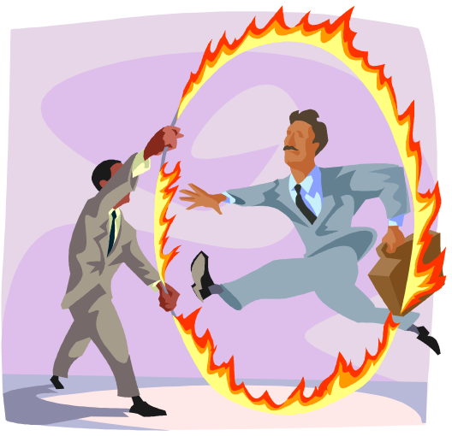
Other Problems
Self-plagiarism.
Staff member misconduct.
Editor misconduct.
Confidentiality.

Slide 25
Prepare Cover Memo
Your name.
Date.
Title of assigned article.
Footnotes you handled.
List of still-missing sources and your efforts to obtain them.
List of substantive problems.
List of validity problems.

Slide 26

Cover Memo Contents
List of problem citations and the rules you used.
Follow-up areas.
Any other helpful information.

Slide 27
Final Matters
Make sure your work is legible.
If you recopy, have someone help you proofread the changes.
  If you lose the changes, we might not ever find them again.
Meet the deadline.
Record time accurately.
Request feedback.
  Re-do policy.
  Evaluation form.

Slide 28
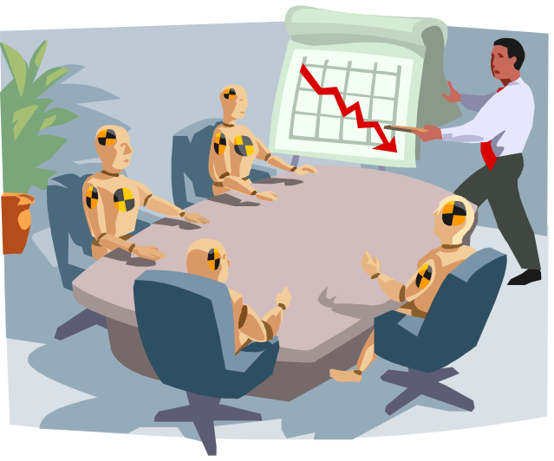
A Few Last Words
This is an important job.
We’re depending on you.
Let’s look at a sample.

